Slide 1


Project Presentation
Predictive Analytics for Health & Life Insurance
Presented By: Deepanshu Bansal, 500107573
Girish, 500109971
Aaditya Gaurav, 500107112
Tanay Garg, 500108691
Presented to:
Dr. Manish Pandey

Slide 2

Problem Statement
In the rapidly evolving insurance industry, accurately predicting health and life insurance costs has become a critical challenge. Traditional methods often fail to capture the complex relationships between customer demographics, medical history, lifestyle habits, and risk factors. This leads to inaccurate premium pricing, increased fraud risk, and poor customer experience. The goal is to leverage predictive analytics and machine learning techniques to build a robust model that can estimate insurance charges more precisely, enabling insurance companies to make data-driven decisions and offer personalized, fair, and profitable policies.

Slide 3
Objective
The main goal of our project is to build a smart system that can predict health insurance premiums for individuals using machine learning.
This can help insurance companies make better decisions while giving customers a clear idea of what affects their premiums — like age, smoking habits, income, and health conditions.

Slide 4
Dataset Overview
Our dataset is focused on understanding and predicting health insurance premiums in the United States. It contains information about a large number of individuals who have health insurance. The data includes different personal and lifestyle-related details that can affect how much a person pays for their insurance.
The dataset is synthetically generated with 1 million entries using a script which represents the actual population of insured people in the US.
Dataset Features
Numerical Features
Age
BMI
Number of Children's
Charges

Slide 5
Gender
Smoker
Region
Medical history
Categorical Features
Family medical history
Exercise frequency
occupation
Coverage level

Slide 6
Data Preprocessing
Before training the machine learning model, we needed to clean and prepare our data properly. This step is called data preprocessing. It helps improve the model accuracy and speed.
1. Handling Missing Values
Real-world data often has some missing values — in our dataset two columns many values is missing.
We handled this by:
To handle missing values we apply data related to the column meaning.
This ensures that no row is removed due to missing values, and our model still gets all available data for learning.

Slide 7
2. Label Encoding
Machine learning models don’t understand text, so we converted categorical columns into numeric form.
Examples:
‘male’ → 1, ‘female’ → 0
‘yes’ → 1, ‘No’ → 0
‘Premium’ → 1, ‘Basic’ → 0, ‘Standard’ → 2
This helps the model differentiate between categories using numbers.
3. Feature Scaling (Standardization)
In our dataset columns like age, BMI, income have different ranges. This creates imbalance in learning.
We used StandardScaler to bring all numeric features to the same scale.
This improves model training by giving equal weight to all features.

Slide 8
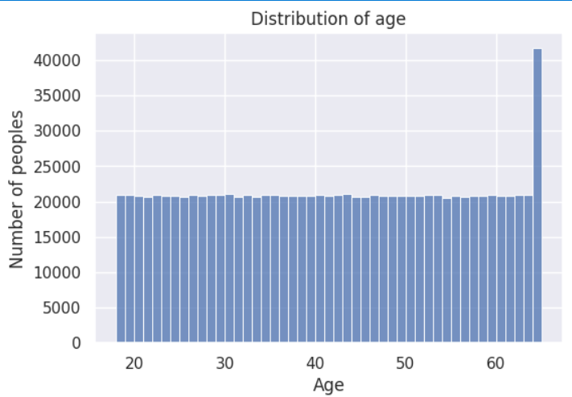
Exploratory Data Analysis (EDA)
EDA is the process of examining the dataset to understand its main characteristics. It helps us discover patterns, detect anomalies, test hypotheses, and check assumptions using visual methods.
Distribution of Age
The majority of individuals fall between the age range of 15 to 70. Since age correlates with health risks, it plays a major role in premium calculation.

Slide 9
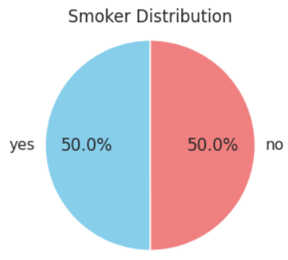
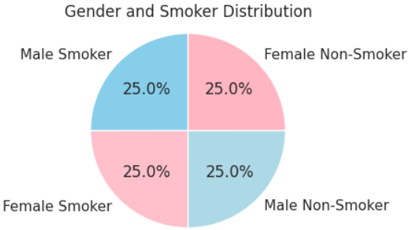
2. Distribution of Smoker
A clear division is visible between smokers and non-smokers. Smokers usually face higher insurance costs due to greater health risks.
3. Distribution of Gender and Smoker
This graph shows smoker distribution within gender groups.
Male smokers are a prominent high-risk category affecting premium predictions.

Slide 10
Model Building
We trained multiple machine learning models to predict the health insurance premium amount. We used common regression algorithms like Linear Regression, Tree-based models, etc. Each model was evaluated using MAE, RMSE and R² Score to find the most accurate and efficient one.
Our goal was to select the model that provides the lowest error and best generalization on unseen data.

Slide 11
Algorithms Used
1. Linear Regression
This is a simple model that tries to draw a straight line through the data to predict the insurance premium. It works best when there is a clear linear relationship between the features and the premium.
2. Decision Tree
This model works like a flowchart – it splits the data and predicts the premium. It's easy to understand and visualize.
3. Random Forest
Random Forest creates many decision trees and combines their outputs to make a better prediction. It reduces errors by averaging the results of multiple trees, making it more accurate and stable.

Slide 12
4. Gradient Boosting
This model also builds multiple trees, but in a smart sequence. Each tree tries to fix the mistakes of the previous one, which helps improve prediction gradually.
5. Fully Connected Neural Network (FCN)
A Fully Connected Neural Network mimics how our brain works – with layers of nodes connected to each other. It learns complex patterns in the data and performs well when trained with enough data.
6. 1D Convolutional Neural Network (1D-CNN)
1D-CNN is a deep learning model usually used for sequences, but it also works great for structured numeric data like ours. It automatically finds important patterns in the features using filters, helping in better predictions.

Slide 13
Model Evaluation
Algorithm | MAE | RMSE | R2_score
Linear Regression | 2472.47 | 3026.13 | 0.5294
Ridge | 2472.47 | 3026.13 | 0.5294
Decision Tree Regressor | 408.74 | 510.09 | 0.9866
Random Forest Regressor | 297.90 | 362.29 | 0.9932
Gradient Boosting Regressor | 476.51 | 597.05 | 0.9817
Fully Connected Neural Network | 7.63 | 9.85 | 0.9963
1D Convolutional Neural Network | 9.59 | 11.90 | 0.9974

Slide 14
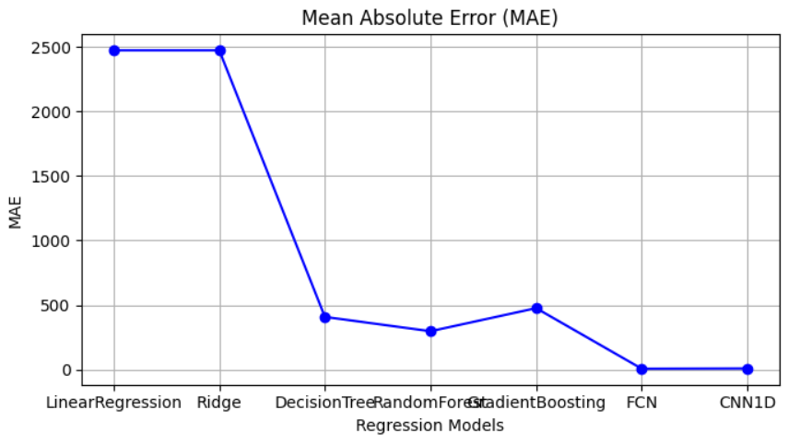
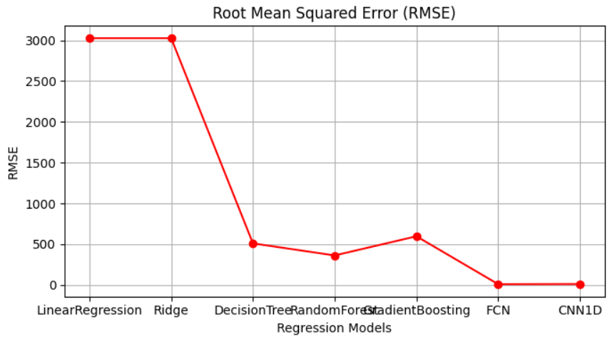
Graphical Representation
Mean Absolute Error
Root Mean Square Error

Slide 15
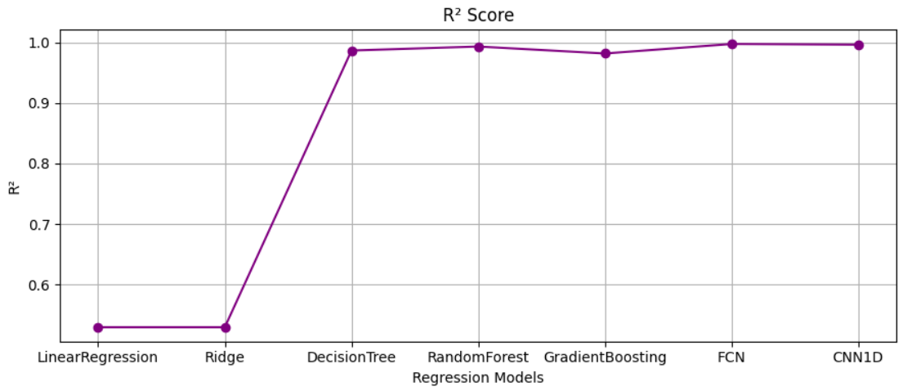
R2 Score

Slide 16
Best Performing Model
Best Performing Model: 1D CNN
Why it performed best?
It captures local trends and interactions between features (like age, BMI, and medical history).
Works well for large datasets with structured inputs.
Learns complex, hidden relationships automatically without manual feature engineering.
Final Outcome: 1D CNN gave the highest accuracy and lowest error in predicting insurance premiums.

Slide 17
Thank You

